Slide 1

CROP PREDICTION
Using Machine Learning

Slide 2

Table of Contents
Company Profile
Introduction
Objectives
Dataset Details
Tools and Methods
System Architecture
Proposed System
Algorithm
Advantages
Requirements
Conclusion

Slide 3
Company Profile
• Company Name: Softron Pvt. Ltd., Kolhapur
• Company Mentor Name: Mr. Rohan S. Suryawanshi
• Company Address: Softron Technologies
Sideshri Plaza 4th Floor, Rajaram Road, Laxmipuri, Kolhapur – 416002.
-For details visit website: https://www.softron.in
About Company:
Softron IT Solutions provided me Industrial training program which allowed me as a trainee to work on the Industrial Project, which is very helpful for any trainee for his/her future prospects. Training program basically insists upon developing the student's ability to think dynamically and to widespread the logical ideas. This institute provided me a glimpse how things work in the corporate world . Moreover, since the joining I have honed many skills such as Time Management ,Team-Work,how to collaborate with your team , how to distribute the tasks effectively.

Slide 4
Introduction
-Crop prediction using machine learning is a cutting-edge application of data science in the field of agriculture.
-This research holds immense significance as it addresses critical challenges faced by the agricultural sector.
-Accurate crop prediction helps ensure a stable food supply, contributing to global food security.
-In a changing climate, crop prediction assists in adapting farming practices to new conditions.
-Crop prediction using machine learning not only benefits farmers but also has broader implications for global food production and sustainability.

Slide 5
Objectives
Our research aims to achieve the following objectives:
Crop Yield Prediction: To develop accurate machine learning models that predict crop yields based on environmental factors such as temperature, humidity, pH, and rainfall.
Crop Classification: To classify crops (label) based on their environmental requirements and growth characteristics, aiding in crop management.
Nutrient Optimization: To recommend optimal nutrient levels (N - nitrogen, P - phosphorus, K - potassium) for different crops, maximizing their growth potential.
1
4.Crop Rotation Guidance: To provide insights into crop rotation strategies that improve soil health and reduce disease risks.
By achieving these objectives, our study seeks to enhance agricultural productivity, sustainability, and resilience in the face of changing environmental conditions.
2

Slide 6
>Dataset comprises various features crucial for crop prediction and management, including:
Dataset
Temperature: Affects crop growth rates and determines suitable planting seasons.
Humidity: Essential for soil moisture, impacting seed germination and root development.
pH: Influences nutrient availability and plant nutrient uptake.
Rainfall: Ensures adequate water supply, critical for plant growth and yield.
Label (Target Variable): The crop to be predicted, which guides crop-specific recommendations.
N (Nitrogen): Key for plant protein synthesis, impacting overall growth and yield.
P (Phosphorus): Necessary for energy transfer within plants and root development.
K (Potassium): Supports photosynthesis, water uptake, and disease resistance.
Cid (Crop_ID): Identifies the specific crop type, enabling tailored predictions.

Slide 7
Tools and Libraries
Python: Python served as our primary programming language.
Scikit-Learn: We leveraged Scikit-Learn, a widely-used machine learning library which provides a user-friendly interface for various machine learning algorithms.
Pandas: Pandas played a crucial role in data manipulation and analysis.
NumPy: NumPy was instrumental in numerical and mathematical operations essential for machine learning computations.
Matplotlib and Seaborn: These libraries enabled us to create informative data visualizations.
Jupyter Notebook: Jupyter Notebook provided me a reproducible environment for our data analysis and modeling. It allowed us to document and share our work effectively.

Slide 8
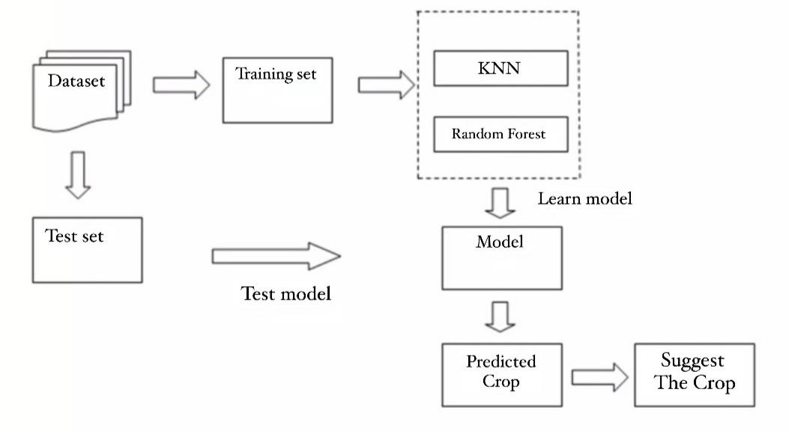
System Architecture
FLOWCHART
This high-level system architecture diagram for crop prediction using machine learning involves visualizing the flow of data and processes.

Slide 9
Proposed System
-Different Machine learning techniques are used and evaluated in agriculture for estimating the future year's crop production.
-Our system focuses on creation of a prediction model which may be used for future prediction of crop. It presents a brief analysis of crop prediction using machine learning techniques.
-The aim of proposed system is to help farmers to cultivate crop for better yield. The crops selected in this work are based on important crops from selected location. The selected crops are Rice, Jowar, Wheat, Soybeans, and Sunflower, Cotton, Sugarcane, Tobacco, Onion, Dry Chili etc.
-Crop Prediction can be done using different features form the dataset. These inputs are passed to the algorithms that I have used for calculating the accuracy. These algorithms will predict crop based on present inputs.

Slide 10
Algorithm Selection
In our study, we employed a range of machine learning algorithms, including:
Random Forest Classifier: We chose Random Forest for its ability to handle both classification and regression tasks effectively, making it suitable for crop classification.
Decision Tree: We selected them to gain insights into feature importance and because they can handle both categorical and numerical data.
Logistic Regression: Logistic Regression is a simple yet powerful classification algorithm. We used it as a baseline model due to its simplicity and interpretability
K-Nearest Neighbors (KNN): KNN algorithm chosen for its flexibility in handling classification tasks. It relies on the similarity of data points, making it useful when patterns in the data are not well-defined.

Slide 11

Advantages
Advantages of Machine Learning in Crop Prediction
Data-Driven Decisions: Informed decision-making for farmers.
Improved Soil Health: Enhanced soil quality.
Increased Yield: Higher crop yields.
Climate Adaptation: Strategies for climate change resilience.
Accuracy: Improved accuracy in crop yield predictions.
Resource Optimization: Efficient use of water, fertilizer, and labor.
Cost Reduction: Lower production costs.
Crop Variety Selection: Machine learning can suggest the best crop varieties based on historical data and environmental conditions.

Slide 12
System Requirements
Hardware Requirements:
Software Requirements:
Processor: Intel Core i3
RAM: 8 GB
ROM: 256 GB
·Operating System: window OS
·Programming language: Python
·Internet and Browsing Facilities

Slide 13
Conclusion
Our study demonstrates the potential of machine learning in crop prediction, showcasing its benefits for agriculture.
The crop prediction model achieved high accuracy in yield prediction and crop classification, enhancing resource management.
This system offers practical solutions for farmers, leading to improved crop yields, resource efficiency, and environmental sustainability.

Slide 14
Thank You
For Your Attention

